Slide 1
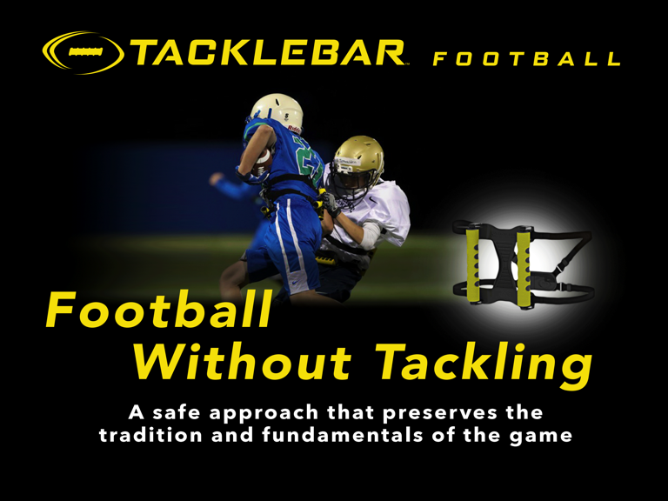

Slide 2
What issues are we addressing?
Parents concern for player safety
Declining participation

Slide 3
What is TackleBar Football?
A safer approach to the game that preserves the tradition and spirit of the game.
The TackleBar harness holds two foam bars across the lower back.
The defender must use form tackling technique to engage the ball carrier. Once wrapped, they rip the foam bar off the ball carrier to down the play. Staying on their feet.

Slide 4
Why TackleBar?
Decreases injuries by reducing hits and high impact collisions
Teaches proper form tackling technique
Ideal transition between flag football and tackle football
Increases participation

Slide 5
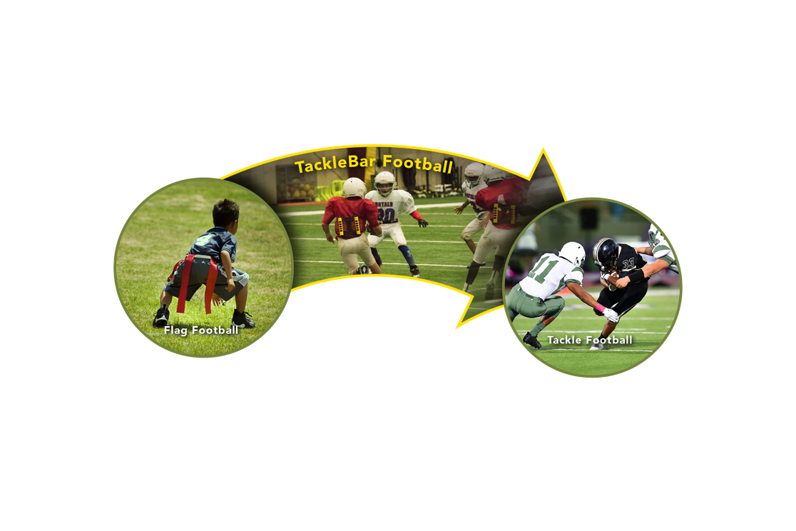
The Football Progression

Slide 6
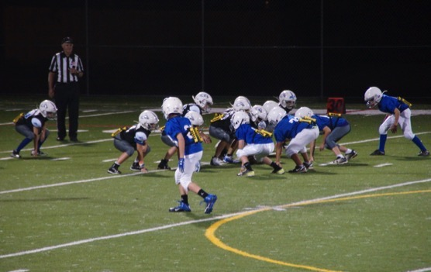
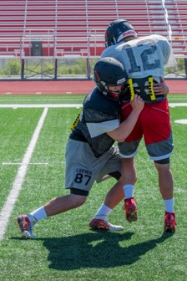
TackleBar for Games
TackleBar for Practice
For the last three seasons youth leagues have utilized TackleBar as a modified game until their players are old enough and ready for full contact.
TackleBar integrates seamlessly with programs, and requires no adjustments other than use of the harness to keep contact at safer levels while providing players a real football experience.
TackleBar supports the football development model.
TackleBar is an invaluable practice and scrimmage tool.
As programs are facing more restrictions on contact, the TackleBar harness facilitates the closest simulation of game speed tackling.

Slide 7
Playing TackleBar Football as a Game
Equipment
Target age- the transition year from flag
Equipment:
  Standard protective equipment plus a TackleBar Harness
Special Teams:
  No kick-offs, ball is placed on 30 yard line.
  Punts: no rush, ball placed where caught or where the ball comes to rest.

Slide 8
Defense
Tackling:
  No tackling or throwing players to the ground.
  No helmet initiated contact.
  Players may never leave their feet to launch or dive into another player.
Wrap and Rip™ Technique is recommended. Defender breaks down, wraps ball carrier and rips TackleBar™ – simulates latest recommended shoulder tackling technique.
It is not a penalty if the ball carrier inadvertently goes to the ground during this action. However, contact that deliberately takes the ball carrier to the ground with force would be a penalty.

Slide 9
Offense
No weight restriction for RB/QB.
No helmet initiated contact.
No blocking below the waist.

Slide 10
Coaches Feedback
Our tackling got better once we started using TackleBar. My middle linebacker started the year leading with his head down on most tackles but finished the year as our best defensive player with over 100 tackles.
-Defensive Coordinator, Illinois high school
So far we have used TackleBar each day during skelly and some days during team time. It’s a great way to encourage good technique while mitigating contact. Loving them so far. -Head varsity coach, Ohio high school
We had 30 2nd and 3rd graders this year, which was up from last year by 10 players. We had a great experience with the tackle bars this year. We are very pleased with an option that seems to ease parents concerns, but still teaches fundamentals of tackling. -Head Coach, Crawfordsville, IN

Slide 11

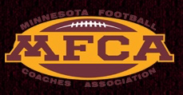
Support for TackleBar
“I’ve always loved football. And now as a reporter whose job it is to cover professional football, I get to see the sport at the highest level. I’ve also learned about the dangers of the game. And as a Mom, those dangers concerned me. So when my son had the opportunity to play TackleBar Football at school, the entire family was thrilled. My son can put on the helmet and pads and play this game without the fear of serious collisions. One of his friends, whose Mom did not want him to play football, joined the team mid-way through the season after his mom learned how TackleBar is different. I am thrilled that my son can play the game he loves and learn its fundamentals in a safer environment. Last fall was fun, and my son informs me that this upcoming fall a lot more of his friends will be joining the team.
Thank you, TackleBar!”
Michele Tafoya
Winner of three Emmys for Sports Reporter

Slide 12
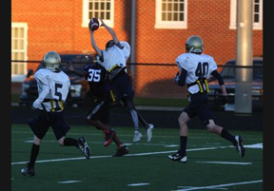
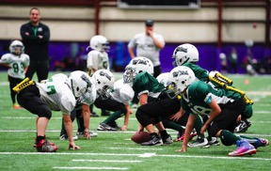
2016 – Pilot Season
  2 Leagues, 148 kids.
  No concussions, 1 injury (broken arm) in 80+ games.
  38% increase in participation compared to previous year.
2017
  Over 2,000 players using TackleBar
  No concussions, 3 injuries
  17% additional growth in original 2 leagues

Slide 13
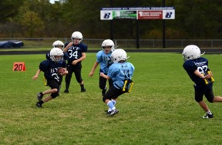
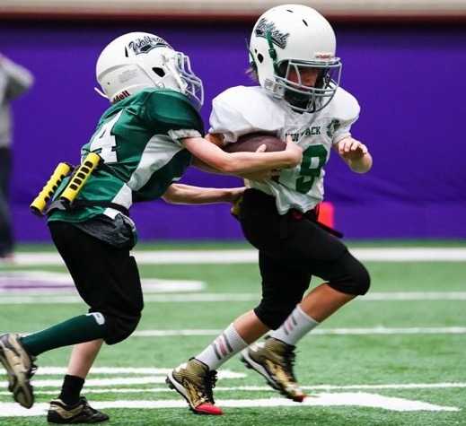
2018
  Over 6000 players using TackleBar
  21 States and Canada, 135 communities/teams participating
  Injury data collected from 926 players
  No concussions, 5 injuries
2019
  Over 8000 players using TackleBar
  27 States, Canada, Germany and Australia
  200+ communities/teams participating
  Injury data published in Orthopedic Journal of Sports Medicine
  Riddell Partnership

Slide 14
2017 Post-Season Parent Survey
“I felt TackleBar was a safer
way to play football.”
“TackleBar games and practices provided a real football experience.”

Slide 15
2018 Post-Season Parent Survey
84% felt TackleBar was safer than tackle football.
76% felt TackleBar was a real football experience.
83% would recommend TackleBar to others.
Approximately 20% of the kids who played TackleBar this season would not have played football at all if TackleBar had not been offered.

Slide 16
Parent Feedback
“This program allowed my husband and I to feel comfortable allowing our son to play football this year.”
“Really glad to have the opportunity for a safer option to play football. Please continue to offer and expand it.”
“I like the transition from flag to tackle bar football and then to regular football--from no contact to some contact to full contact.”

Slide 17
Injury Rates In TackleBar Football
Orthopedic Journal of Sports Medicine
Sponsored by the University of MN and Dr. Uzma Samadani, who compared our data to other published data for incidence of injury in both youth tackle and flag.
We gathered injury data on 926 players we had <1 injury per 1000 games and practices, zero concussions.
We collected over 16,000 Athletic Exposures, AE’s (one practice or one game represent one AE).

Slide 18
Injury Rates In TackleBar Football
Orthopedic Journal of Sports Medicine
Results:
We had only 5 injuries meet the threshold (you had to miss a subsequent practice or game).
Our incidence of injury was .31/1000 AE’s and 0 for concussions.
  Dompier et al reported in JAMA 2.25/1000 AE’s and .99 for concussions in 2015.
  Peterson et al reported in the Ortho Journal of Sports Medicine in 2017 2.6/1000 AE’s and .68 for concussions.
  Peterson reported 5.77 for injuries and 1.33 for concussions /1000 AE for flag football.

Slide 19
Injury Rate
(per 1000 Athletic Exposures)
Youth
Tackle
Youth
Tackle
Flag
TackleBar
References
Dompier TP, Kerr ZY, Marshall SW, et al. Incidence of Concussion During Practice and Games in Youth, High School, and Collegiate American Football Players. JAMA Pediatrics. 2015;169(7):659-665
Peterson AR, Kruse AJ, Meester SM, et al. Youth Football Injuries: A Prospective Cohort. Orthop J Sports Med. 2017;5(2):2325967116686784.

